Slide 1

JavaScript
Andrew Beatty
Andrew.Beatty@gmit.ie
Data Representation

Slide 2
Overview
What you will be able to do: Lab
CSS:
Hidden, block and inline display
Disabled
JavaScript (W3Schools)
Overview of the language
Dom manipulation
Attributes
Setting values and innerHTML
Theory
Exercise
Demonstration
(Rinse and Repeat)

Slide 3
cSS (Cascading Style Sheets)
Can be:
block (new line)
Inline (no new line)
none (not shown)
Too much for this course
Style can be defined:
In another file (with selectors)
In the head (with selectors)
In the element itself
Make an element visible/hidden
Put the keyword disabled in an element to make it disabled
Exercise 2.1:
Write some html that has a hidden element
<div style=“display: block”>
text
</div>
<input type=“text” value=“blah” disabled />
User will not be able to enter text into this input

Slide 4
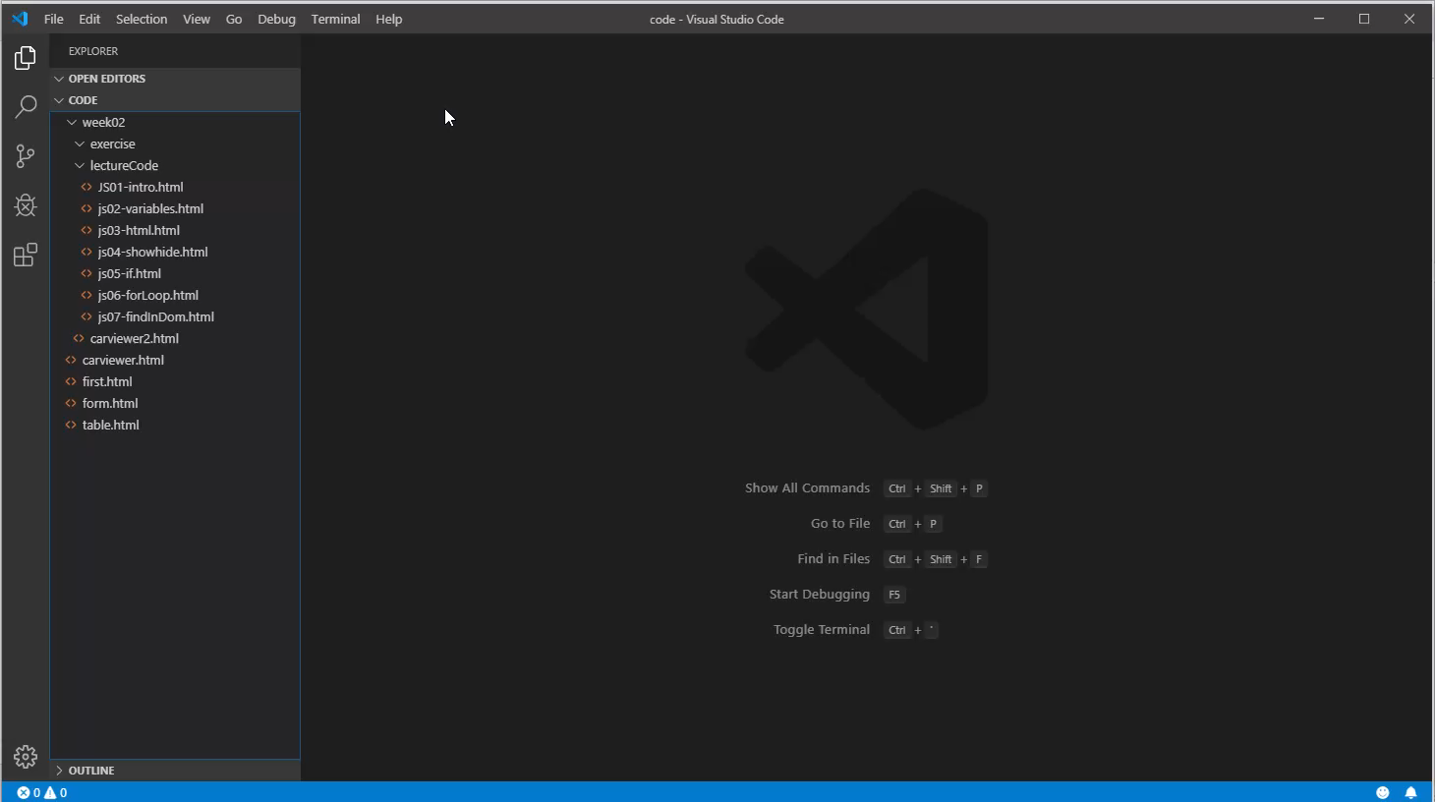

Slide 5
JavaScript
Inside <script></script> tags
Blocks have {} (not indents like in python)
<script>
console.log("hello World")
</script>
Prints to the console, not the page
Name of function
<script>
function sayHelloAgain(){
console.log("hello Again")
}
sayHelloAgain()
</script>
Define block of function
Calls function

Slide 6
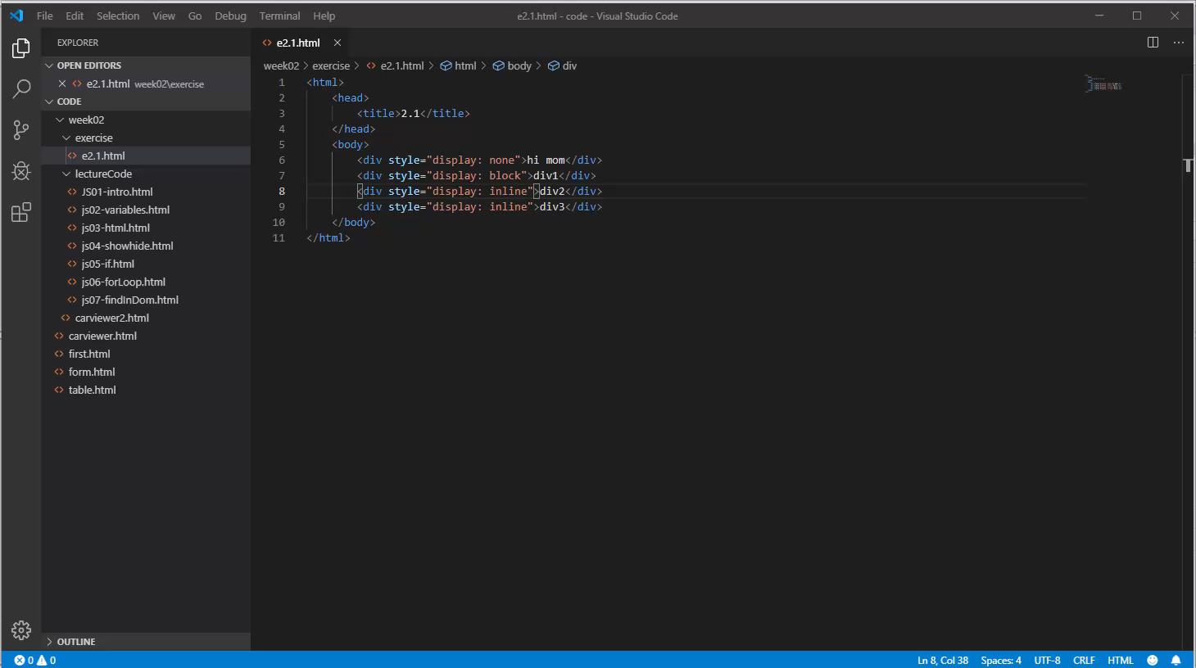

Slide 7
JavaScript to/from html
Onclick attribute
Document getElementById
Exercise 2.3:
Make a webpage with an input and a button, when the user clicks the button then the contents of the input will display in another div
<button onclick="myFunction('hello')">click me</button>
<div id="messageOut"></div>
document.getElementById('messageOut').innerText = message

Slide 8
